Slide 1


ConnectWise: A Next-Gen Social Media App
Revolutionizing Connectivity with Object-Oriented Programming
Code & Presentation Link: https://github.com/Spring-2025-V2-7-Team/Team_7_Final_Project
Isha Paliwal (G49146952)
Venkatesh Shanmugam (G27887303)
Aditi Vyas (G40802010)
Needhi Kore (G20475943)

Slide 2

Agenda
Introduction
Key Features
Core Entities
Requirements & Analysis Models
Use Case Diagram
Activity Diagram
Robustness Diagram
Architecture Model
Domain Class Model
Sequence Diagram
State Diagram
Conclusion

Slide 3

Introduction
ConnectWise is a new social media platform designed to bring people together through intuitive technology.
Our goal is to provide a platform where users can easily share content, communicate, and connect with others safely and securely.
Ideal for college students and young professionals looking for a versatile social experience.

Slide 4

Key Features of ConnectWise
User-Friendly Interface: Designed with simplicity in mind, ensuring all features are easy to use.
Multimedia Interaction: Supports text, photo, and video content, allowing for dynamic posts and interactions.
Security First: Strong privacy settings and data encryption to protect user information.
ConnectWise: A Next-Gen Social Media App

Slide 5
Core Entities of Our Social Media App
User Account: The foundational class for all user types, defining common registration and login behaviors.
Post Entity: An abstract entity serving as a base for all content-related classes including posts, comments, and likes.
Notification: Manages alerts and updates for users, enhancing engagement and interactivity on the platform.
Message: Facilitates direct and private communication between users, supporting a dynamic conversation experience.
ConnectWise: A Next-Gen Social Media App

Slide 6

Requirements & Analysis Models
Defining the technical and user specifications necessary to build and maintain a robust social media platform.

Slide 7
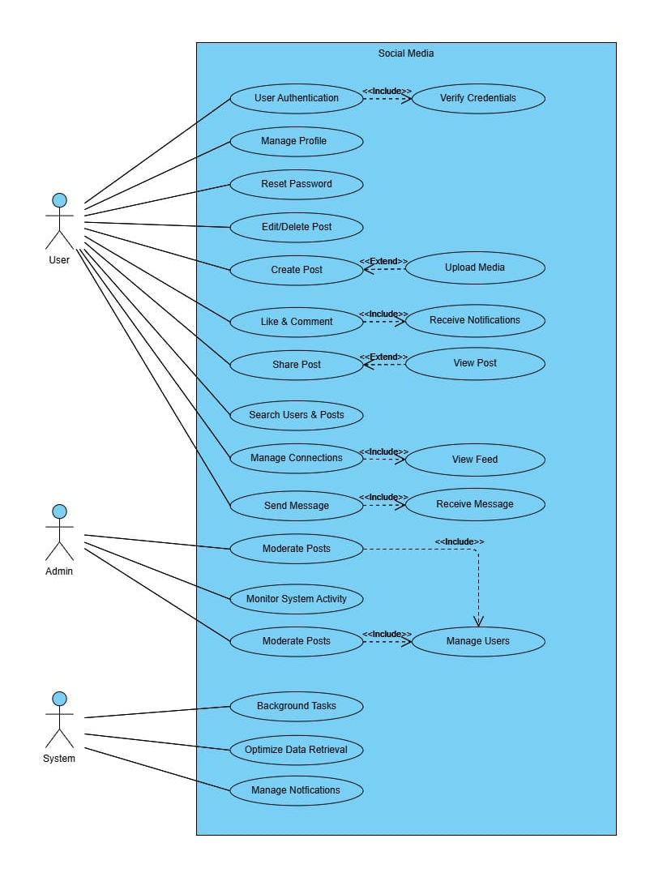
Use Case Diagram
User Functions: Access to post creation, messaging, and profile settings.
Admin Capabilities: Oversee content moderation and user management.
Automated Systems: Manage notifications and optimize data retrieval efficiently.
Interactive Features: Enhanced posting with media upload options.
Security and Usability: Emphasizes user-friendly interfaces with robust security protocols.
Users

Slide 8

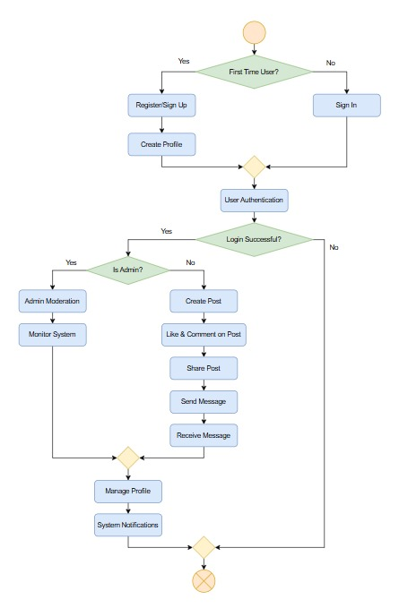
Activity Diagram
User Onboarding: Delineates paths for first-time users through registration and profile creation, and for returning users through sign-in.
Login Validation: Depicts the process of user authentication, branching based on the success of login attempts.
Role-Based Access: Differentiates activities available to regular users and administrators’ post-login, emphasizing system security and user privileges.
User Activities: Outlines user capabilities including creating and managing posts, liking, commenting, sharing, and messaging.
Admin Responsibilities: Focuses on admin-specific functions such as user moderation and system monitoring.
Notifications System: Shows how users manage their profiles and receive system notifications based on certain triggers and interactions.

Slide 9
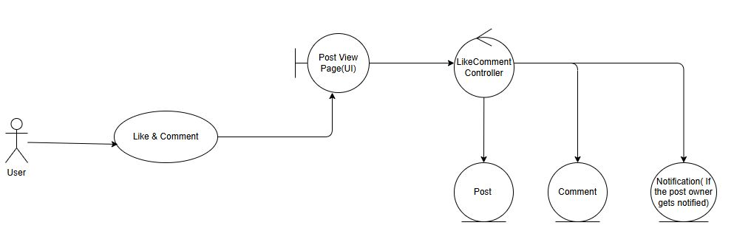
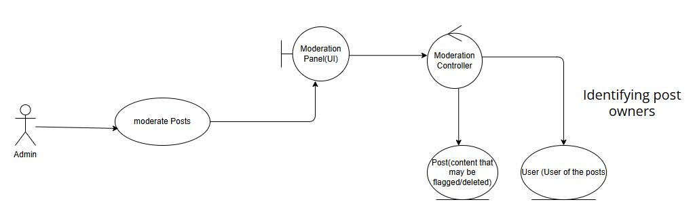
Robustness Diagram
Like & Comment
User Interaction: Users engage with posts directly through the Post View Page, enabling real-time interaction with likes and comments.
Data Flow: The LikeComment Controller manages these interactions, updating post metrics and notifying post owners via the Notification Entity.
Moderate Posts (Admin)
Admin Interaction: Admin accesses the Moderation Panel to review and manage flagged posts, ensuring content adheres to platform standards.
Control Flow: The Moderation Controller processes actions, affecting both the Post and User Entities to maintain community guidelines.

Slide 10
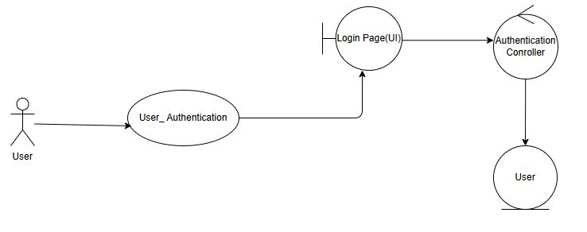
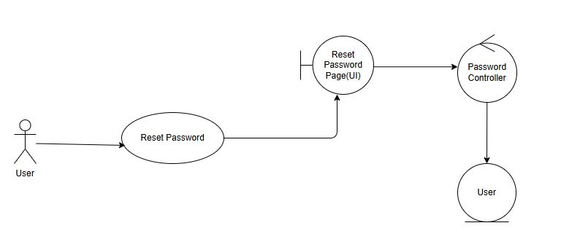
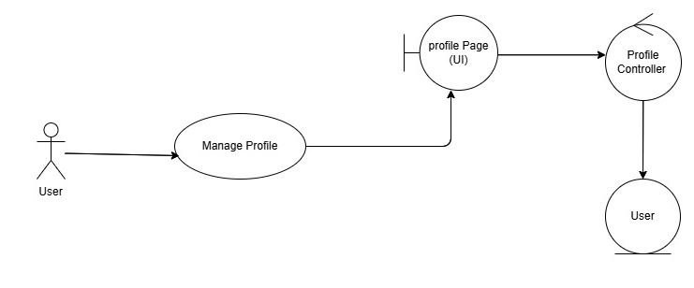
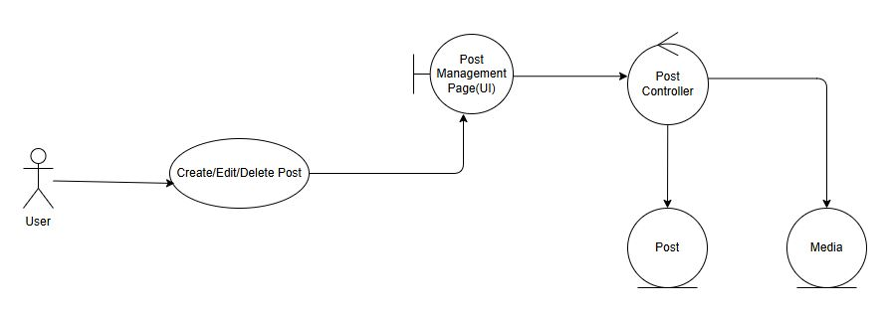
Other Robustness Diagrams
User Authentication
Reset Password
Manage Profile
Create/Edit/Delete Post

Slide 11
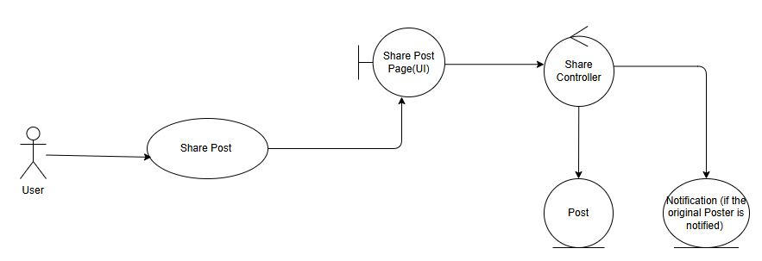
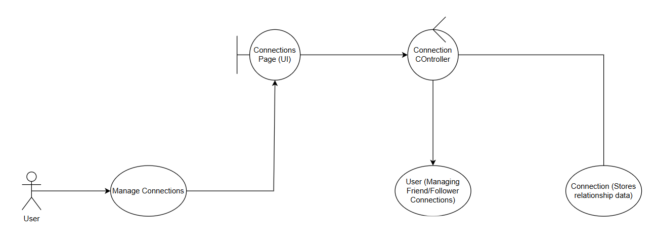
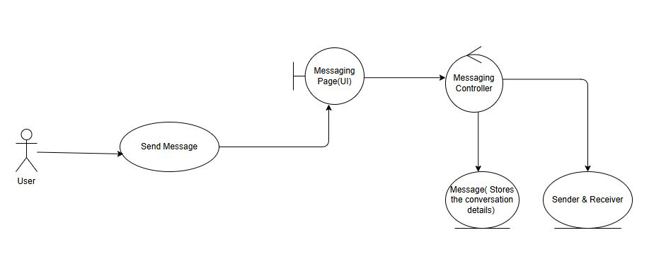
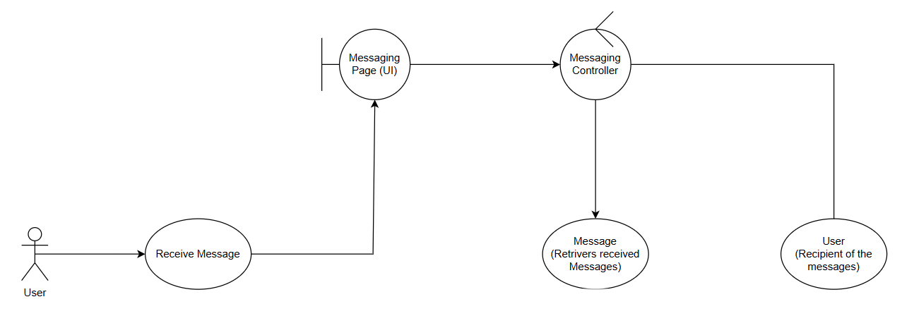
Other Robustness Diagrams
User Authentication
Manage Connections
Send Message
Receive Message

Slide 12
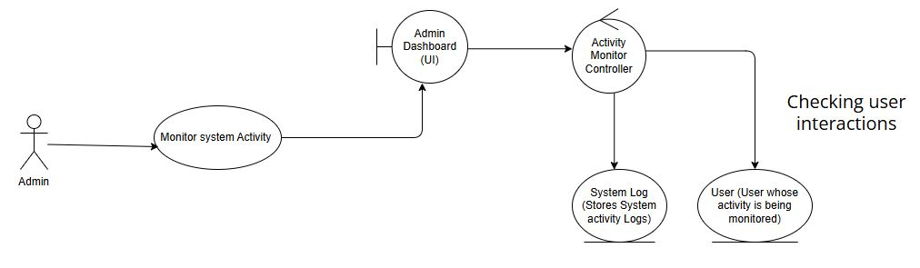
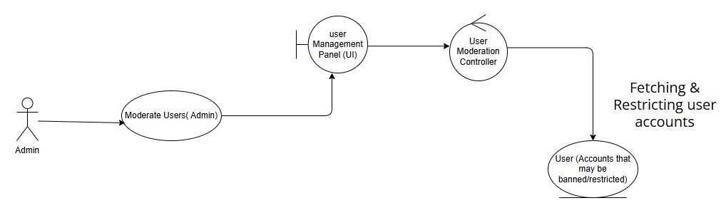
Other Robustness Diagrams
Monitor System Activity (Admin)
Moderate Users (Admin)

Slide 13
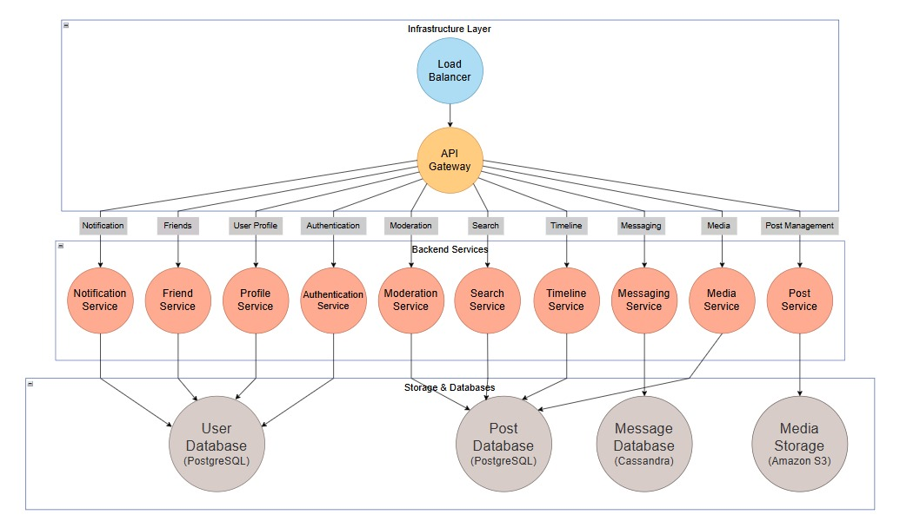
Architecture Model - Backend to Server
Scalable Backend Services: Illustrates the deployment of multiple backend services such as Authentication, Notification, and Timeline, ensuring scalable and efficient handling of user requests.
Data Management: Highlights the use of PostgreSQL and Cassandra for structured data storage and Amazon S3 for media storage, showcasing robust data management solutions tailored for high availability and reliability.

Slide 14
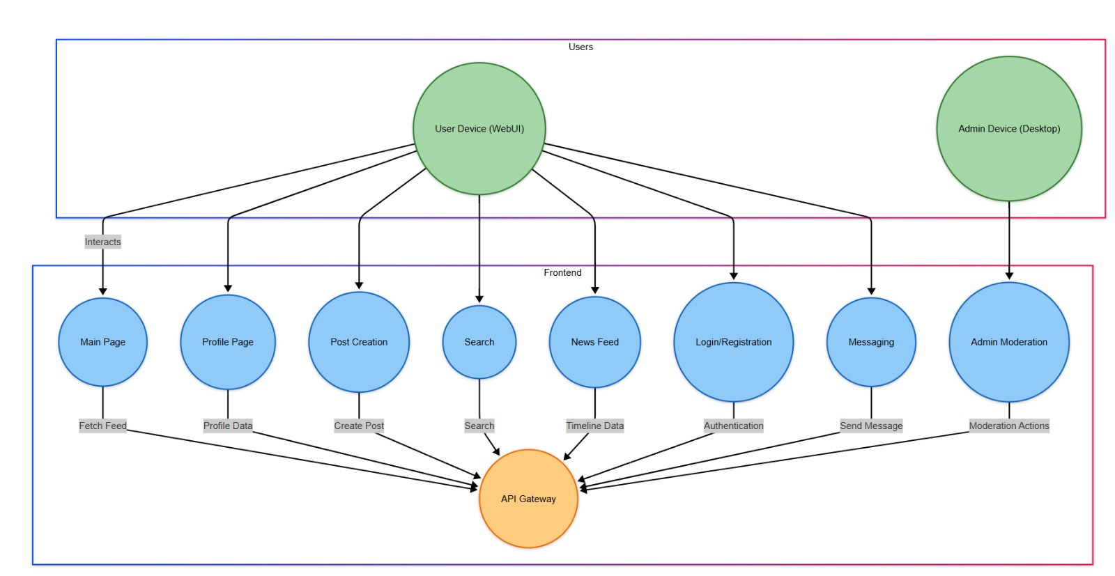
Architecture Model - Frontend to Backend
User Interaction Flow: Shows how user actions on the frontend (like posting, searching, or messaging) are processed through the API Gateway, emphasizing the app’s responsive design.
Service Integration: Details how frontend requests are distributed among various backend services through the API Gateway, ensuring that user interactions are seamlessly managed and scalable.

Slide 15
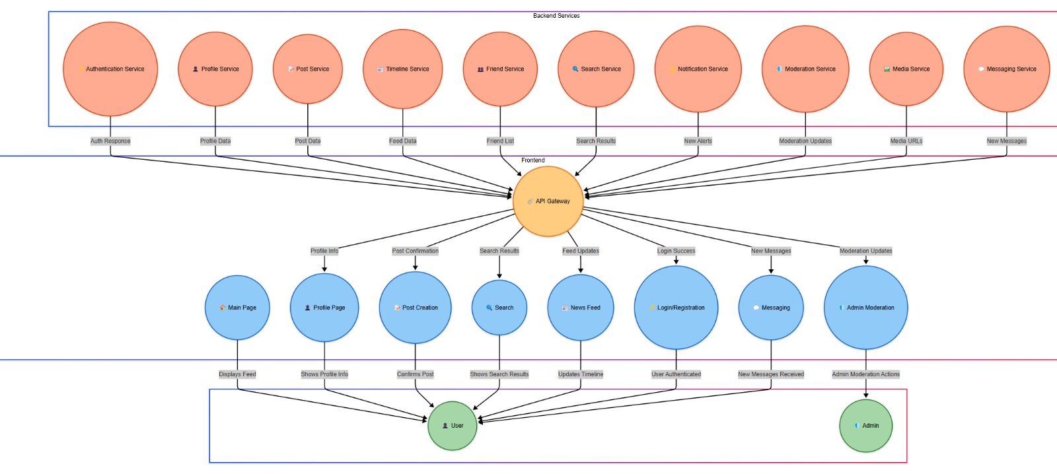
Architecture Model - Reverse Backend to Frontend

Slide 16
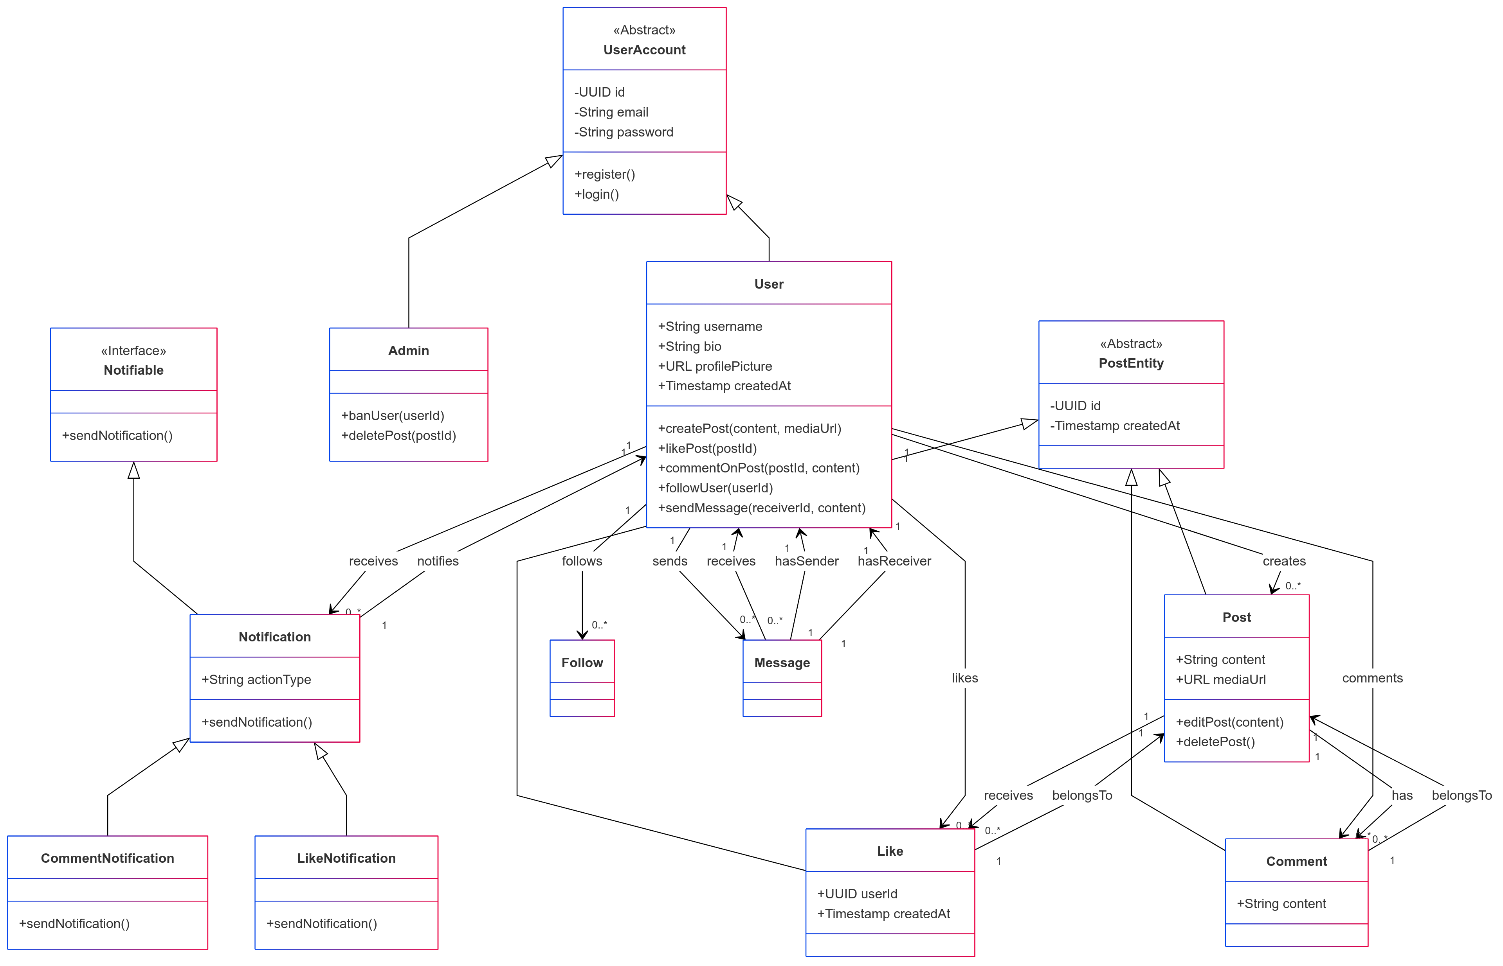
Domain Class Model
Class Hierarchy and User Management: Illustrates the inheritance structure where User and Admin are specialized forms of the general UserAccount, highlighting how different roles interact within the platform.
Core Functionalities and Relationships: Details operations like post creation, editing, and user interactions (like, follow, message), connected through relationships that define how users engage with content and each other.
Notification System Integration: Showcases the implementation of the Notifiable interface by Notification, CommentNotification, and LikeNotification classes to manage and send alerts, enhancing user experience with real-time updates.

Slide 17
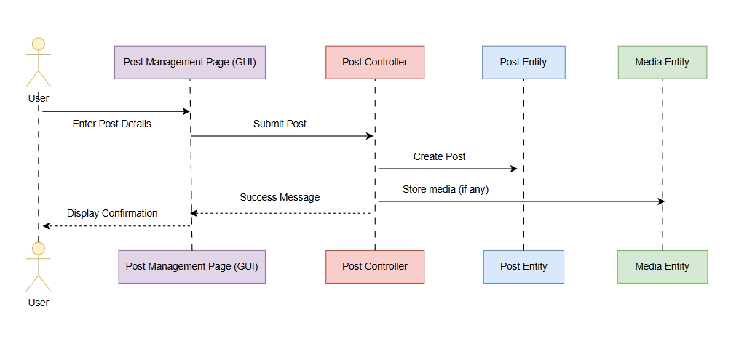
Sequence Diagram
User Interaction with the Post Interface: The diagram demonstrates how a user interacts with the Post Management Page (GUI) by entering post details, which are then processed by the Post Controller to create a new post in the Post Entity, and possibly store associated media in the Media Entity.
Feedback Loop to User: It outlines the feedback mechanism where, upon successful creation of the post, a success message is communicated back to the Post Management Page (GUI), which then displays a confirmation to the user, completing the interaction cycle.

Slide 18
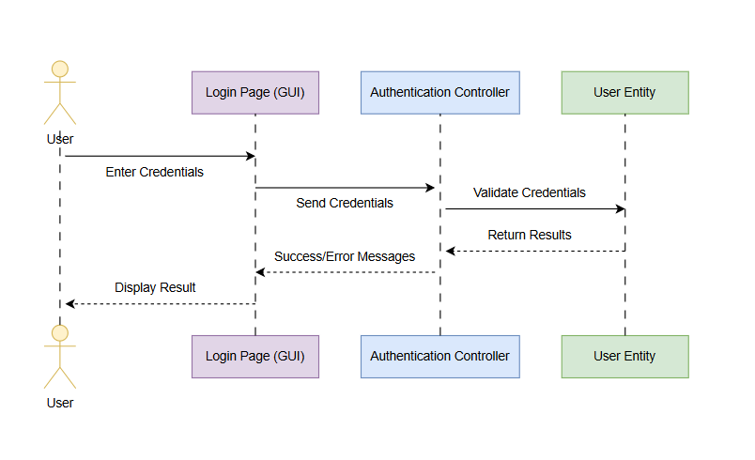
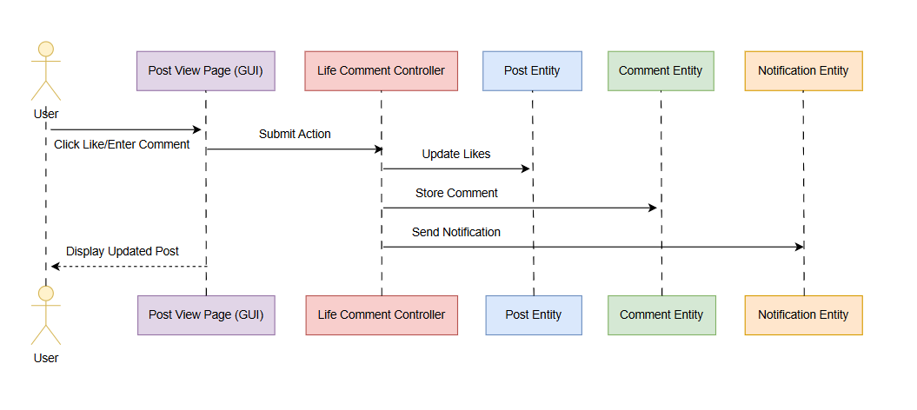
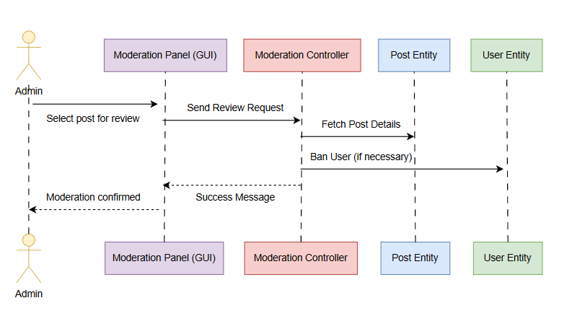
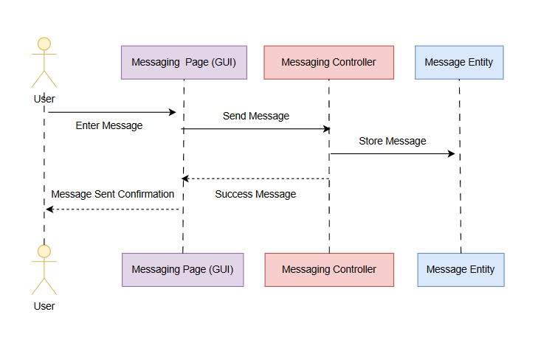
Other Sequence Diagrams
Like & Comment on Post
User Authentication
Send Message
Moderate Post (Admin)

Slide 19
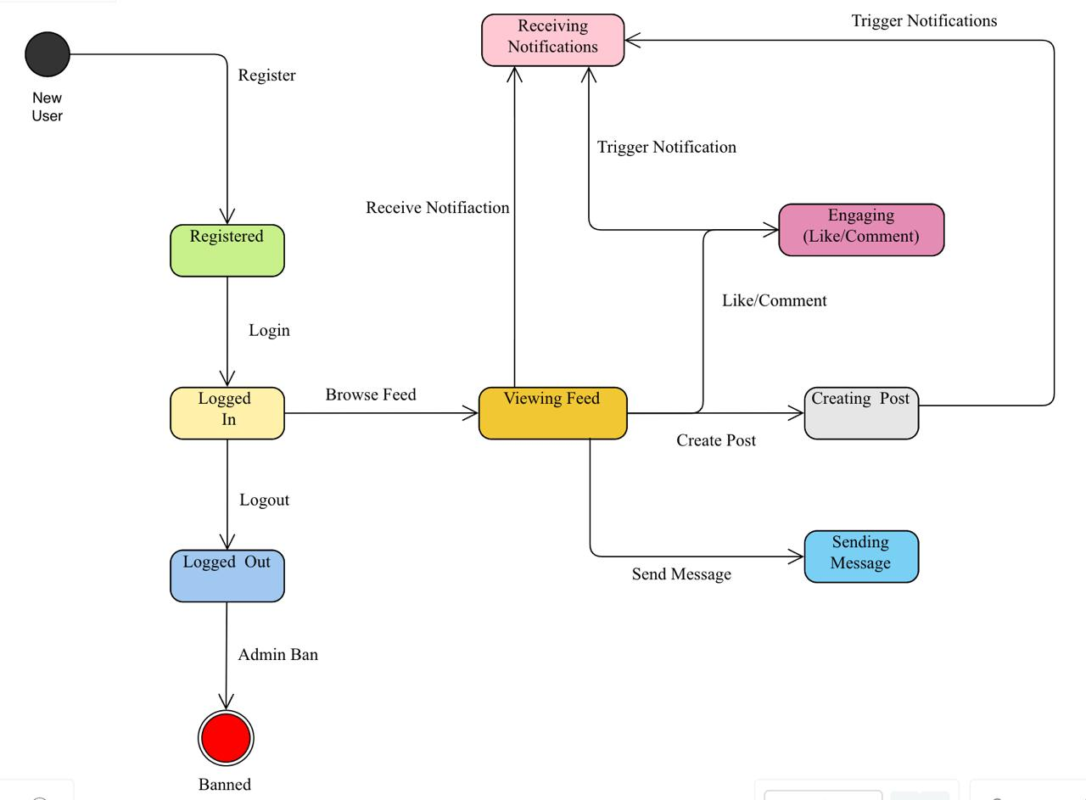
State Diagram
User Journey Overview: Maps out the user's progression from registration to either logging out or being banned, emphasizing the lifecycle of user interaction within the app.
Core Functionalities and Notifications: Highlights key activities such as posting, commenting, messaging, and how these actions integrate with the notification system to keep users engaged.

Slide 20
Conclusion
Achievements:
Successfully outlined the key functionalities and user interactions of our social media platform, demonstrating the comprehensive planning and robust architecture designed to enhance user engagement.
Future Prospects:
We aim to continually refine these functionalities, adding more features such as advanced user analytics and expanded admin capabilities to further enrich the user experience and administrative efficiency.

Slide 21
Thank you

